Slide 1



The RingHopper Journey or How We Almost 0-day’d the World
Benny Zeltser, Intel
Jonathan Lusky, Cellebrite
Generated by the DALL·E 2.5 AI system

Slide 2
How We Almost 0-day’d the World
reported internally
(Jun 1st ’21)
BH+DefCon conferences
(Aug ‘22)
CERT/CC
(Jan 19th, ‘22)

Slide 3
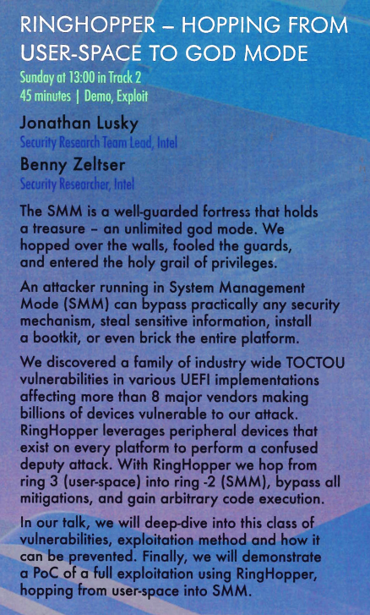
How We Almost 0-day’d the World

Slide 4
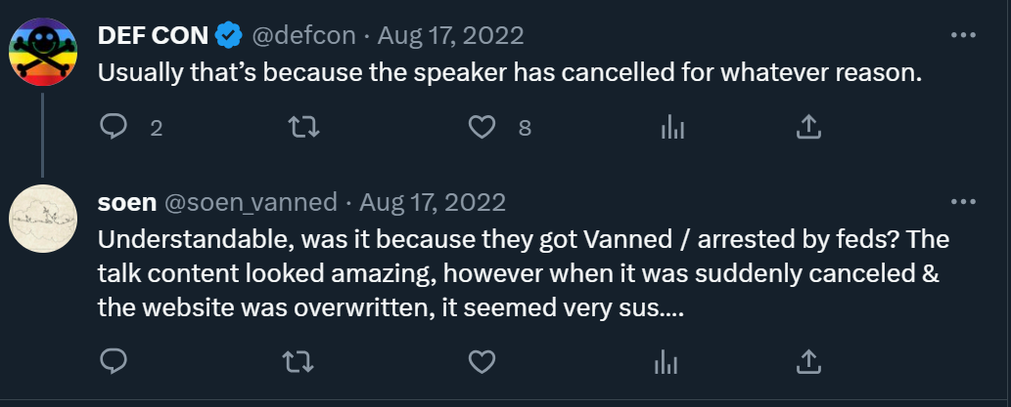
How We Almost 0-day’d the World
https://twitter.com/soen_vanned/status/1559993970742005760?t

Slide 5
How We Almost 0-day’d the World
reported internally
(Jun 1st ’21)
BH+DefCon conferences
(Aug ‘22)
CERT/CC
(Jan 19th, ‘22)
(last) embargo expired
(Nov 8th ’22)

Slide 6
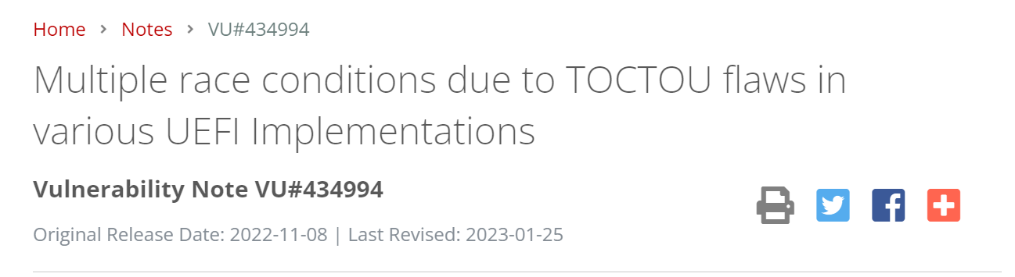
How We Almost 0-day’d the World
https://www.kb.cert.org/vuls/id/434994

Slide 7
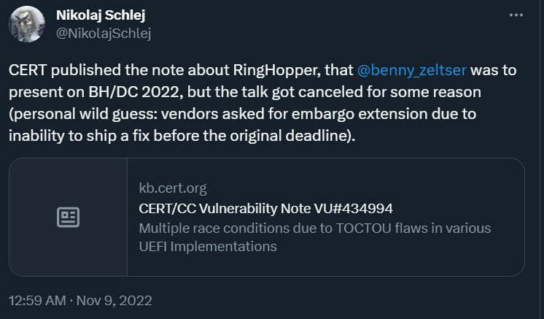
How We Almost 0-day’d the World
https://twitter.com/NikolajSchlej/status/1590116934192091136

Slide 8
How We Almost 0-day’d the World
reported internally
(Jun 1st ’21)
BH+DefCon conferences
(Aug ‘22)
DefCon
(Aug ‘23)
CERT/CC
(Jan 19th, ‘22)
(last) embargo expired
(Nov 8th ’22)

Slide 9
Privilege Rings
User-mode
[Ring 3]
Kernel [Ring 0]

Slide 10
Privilege Rings
User-mode
[Ring 3]
Kernel [Ring 0]
VMM [Ring -1]
SMM [Ring -2]

Slide 11
System Management Mode
Processor operating mode
Provides low-level system functionality:
Power management
System hardware control
Proprietary OEM designed code
Additional functionalities:
Interface to SMBIOS
PS/2 mouse/keyboard emulation
Handle USB events at boot time and run time
...

Slide 12

System Management Mode
SMRAMC[C_BASE_SEG] SMRAMC[G_SMRAME] ESMRAMC[H_SMRAME] ESMRAMC[TSEG_SZ]
ESMRAMC[T_EN]
TOLUD
TSEG
GGC[GGMS]
SMRAMC[D_OPEN]
SMRAMC[D_LCK]
IA32_SMRR_PHYSBASE IA32_SMRR_PHYSMASK
TOLUD Lock
TOUUD Lock
TSEGMB
BGSM
TSEGMB Lock
BGSM Lock
SMM_BWP
SMI_EN[GBL_SMI_EN]
TCO_EN
TCO_LOCK SMI_LOCK
Stack Guard
NULL pointer detection
Heap Guard
Memory Profile
NX Stack
NX/RO Memory
Image Protection
SMM Static Paging
Read-only Page Table
http://gunshowcomic.com/648
https://edk2-docs.gitbook.io/a-tour-beyond-bios-mitigate-buffer-overflow-in-ue/summary/policy_control
“The Memory Sinkhole” by Chris Domas

Slide 13
Invoking SMM From Ring 0
Kernel [Ring 0]
SMM [Ring -2]
System Management Interrupt
SMI handler

Slide 14
System Management RAM
RAM
Hypervisor
User-space apps
SMRAM
Kernel
SMM
Kernel modules
VMs

Slide 15
Privilege Escalation
User-mode
[Ring 3]
Kernel [Ring 0]
VMM [Ring -1]
SMM
[Ring -2]

Slide 16
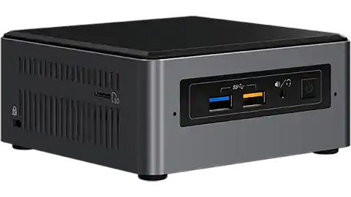
Our Target
Intel® NUC (Next Unit of Computing)

Slide 17
Time of Check Time of Use Vulnerability
if (!Validate(outputBuffer)) {
return ACCESS_DENIED;
}
// [...]
*(outputBuffer) = 0xc0ffee;
check
use
modify the value of outputBuffer

Slide 18
TOCTOU Vulnerability Toy Example
RAM
&outputBuffer
inputBuffer
&SMRAM
outputBuffer
0xc0ffee
SMRAM
0xc0ffee

Slide 19
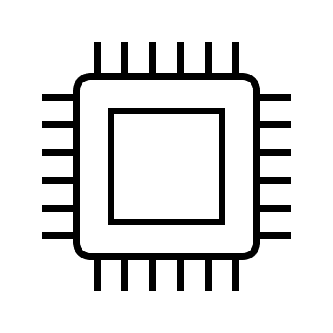

TOCTOU Exploitation
Corrupt
Validate
Corrupt
Use
Corrupt
timeline

Slide 20
DMA is the way of peripheral devices to access RAM directly, without the CPU

Slide 21
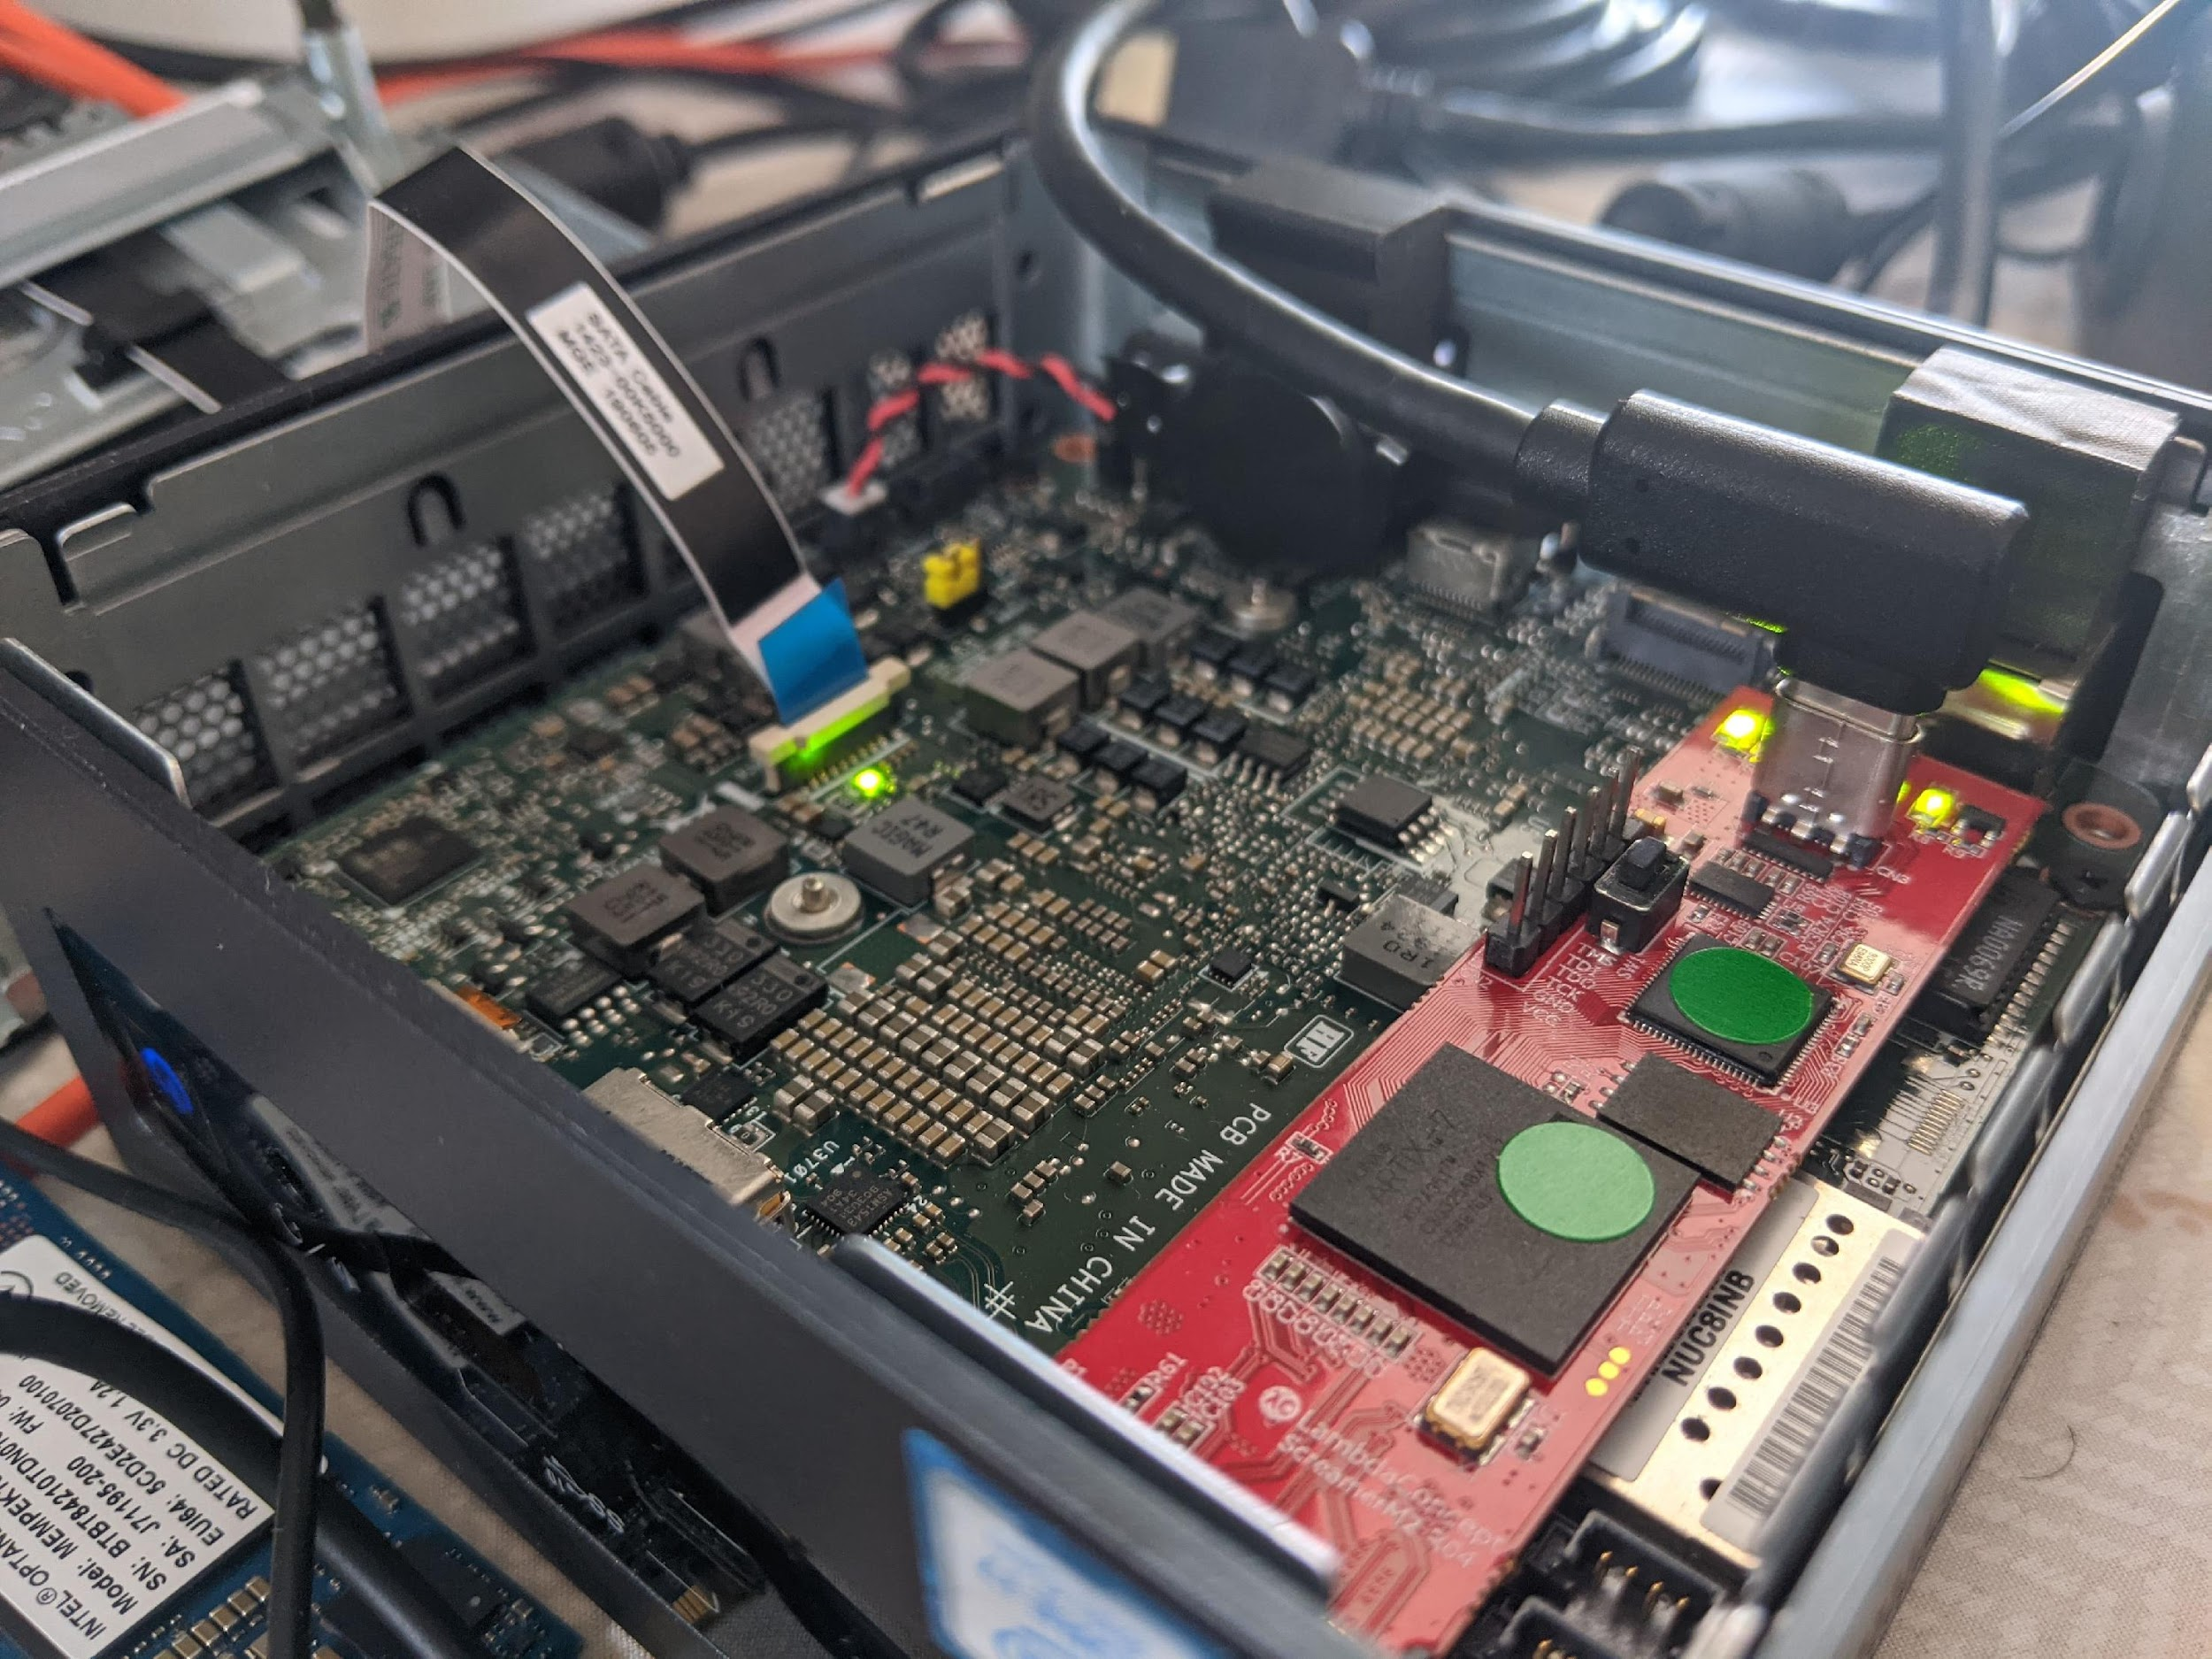
DMA via PCILeech
by Ulf Frisk - https://github.com/ufrisk/pcileech

Slide 22
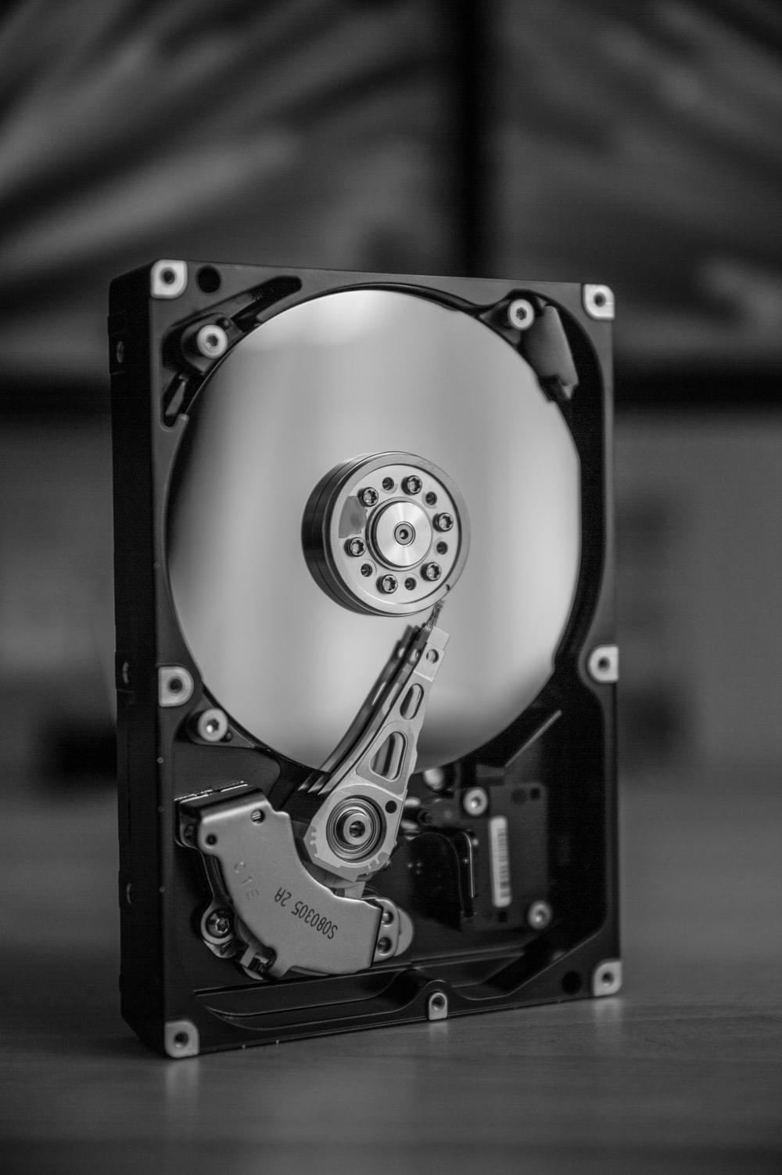
Physical to Remote
Utilized the HDD to perform DMA
Generated DMA transactions based on work by Rafal Wojtczuk in Subverting the Xen Hypervisor
Photo by Frank R on Unsplash

Slide 23

TOCTOU SMM Exploitation
hook
DMA request
⁞
Processing Request
⁞
Trigger SMI
Validate
Returns data
Use
timeline

Slide 24

RECAP
TIME IT IS
photo by Victor Serban on Unsplash

Slide 25
Recap
What is SMM and how to work with it
Turning TOCTOU issues into write primitive to the SMRAM
Manipulating DMA transactions
Executing code in SMM

Slide 26
Code Execution Initial Capabilities
Write-primitives from the
SmbiosDmiEdit DXE driver
**(input_buffer + 2) = 0x28;
**(input_buffer + 6) = sub_2428(qword_6D58, v3);
**(input_buffer + 0xa) = sub_248C(qword_6D58);
**(input_buffer + 0xe) = qword_6C08 ? qword_6C08 : qword_6D58;
**(input_buffer + 0x12) = word_6D68;

Slide 27
Code Execution Classic Approach
Find an executable memory region
Code is RO, data is NX
Forge arbitrary payload
Weak write primitives
Get unrestricted memory access
Not all RAM mapped
+
RO page table

Slide 28

Code Execution Challenges
A classic approach might not work
https://www.mememaker.net/meme/such-challenge-very-hard
=> Let’s try to leverage SMM internal mechanisms to our advantage

Slide 29
Code Execution – Attempt #0

Slide 30
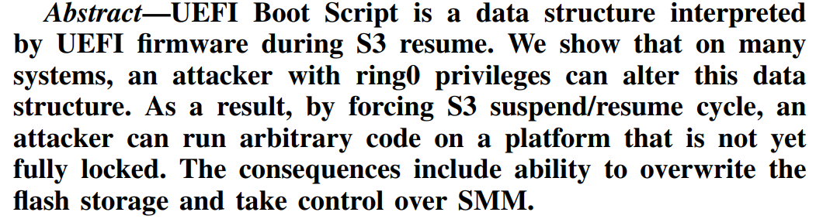

Code Execution – Attempt #0 Digging Up the Past
“Attacking UEFI Boot Script” by Rafal Wojtczuk Corey Kallenberg, 2015

Slide 31
Code Execution – Attempt #0 S3 Sleep State
Z^{ZZ}

Slide 32


Code Execution – Attempt #0 S3 Boot Script
OS load
boot
save
⁞
IO_WRITE_OPCODE
IO_READ_WRITE_OPCODE
MEM_WRITE_OPCODE
MEM_READ_WRITE_OPCODE
PCI_CONFIG_WRITE_OPCODE
⁞
S3 boot script
execute
OS resume
S3 resume

Slide 33
Code Execution – Attempt #0 S3 Boot Script
OS load
boot
saved into location accessible to OS
S3 boot script
execute
OS resume
S3 resume

Slide 34
Code Execution – Attempt #0 S3 Boot Script
OS load
boot
S3 boot script
LockBox
OS resume
S3 resume

Slide 35
Code Execution – Attempt #0 S3 Boot Script – LockBox
Provides integrity of stored data
Located in SMRAM
Standard implementation
API for reading/writing/updating from ring 0

Slide 36
Code Execution – Attempt #0 S3 Boot Script – SmmLockBoxUpdate
VOID SmmLockBoxUpdate (IN EFI_SMM_LOCK_BOX_PARAMETER_UPDATE *LockBoxParameterUpdate) {
// [...]
if ( mLocked) {
DEBUG ((EFI_D_ERROR, "SmmLockBox Locked!\n"));
LockBoxParameterUpdate->Header.ReturnStatus = (UINT64)EFI_ACCESS_DENIED;
return ;
}
// [...]
Status = UpdateLockBox ([...]);
LockBoxParameterUpdate->Header.ReturnStatus = (UINT64)Status;
return ;
}

Slide 37
Code Execution – Attempt #0 S3 Boot Script – The Plan
1
Zero out mLocked
2
Invoke S3 boot script update procedure
3
Go into S3
4
Return from S3
5
Execute code in SMM 😎

Slide 38
Code Execution – Attempt #0 S3 Boot Script
“The function will close and lock SMRAM and then jump to boot script [...]”
S3ResumeExecuteBootScript’s docs

Slide 39

Code Execution – Attempt #0 S3 Boot Script
https://www.reddit.com/r/ProgrammerHumor/comments/lbgkg7/trying_random_stuff_for_2_hours_instead_of/

Slide 40
Code Execution – Attempt #1
The One That Worked

Slide 41
Code Execution SMBASE
SMRAM
SMBASE of core 0
SMBASE of core 1
SMBASE of core 2
⁞

Slide 42
Code Execution SMBASE
SMRAM
SMBASE + 0xFFFF
SMBASE value
SMBASE of core 0
SMBASE + 0x8000 + 0x7EF8
Save State
SMBASE of core 1
SMI Handler
Entry Point
First code executed upon entering SMM
SMBASE of core 2
⁞
SMBASE

Slide 43
Code Execution SMBASE Relocation
SMBASE + 0xFFFF
SMBASE value
SMBASE + 0x8000 + 0x7EF8
Save State
SMI Handler
Entry Point
SMBASE
SMRAM

Slide 44

Code Execution SMBASE Relocation Attack
SMBASE + 0xFFFF
User controlled memory
SMBASE value
SMBASE + 0x8000 + 0x7EF8
Save State
FAILED
SMI Handler
Entry Point
SMI Handler
Entry Point
SMBASE
non-SMRAM
SMRAM

Slide 45
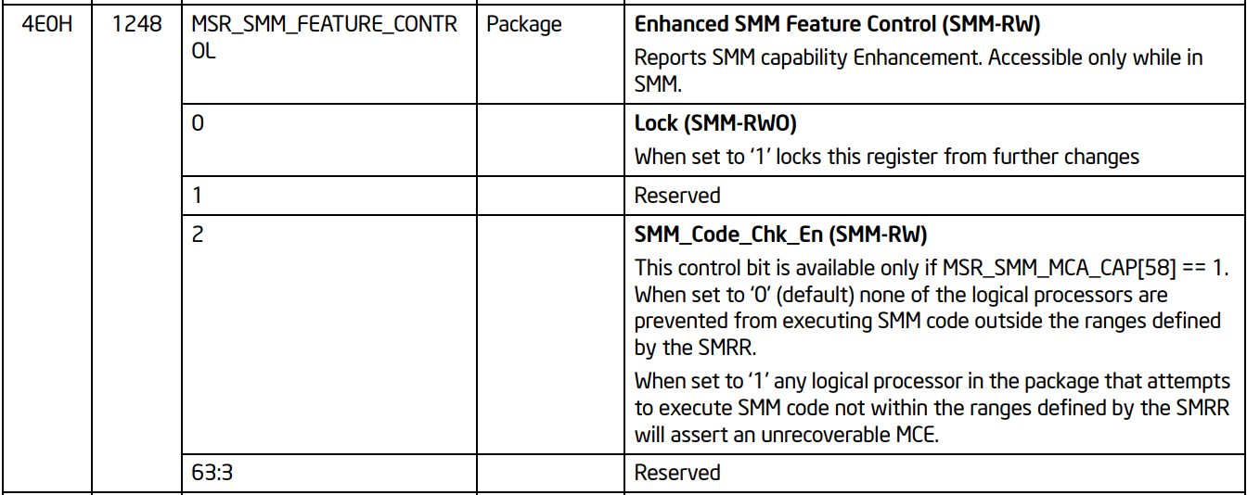
Code Execution SMM “SMEP”
SMM_FEATURE_CONTROL cannot be modified until reboot…
… what if we cut the power to the CPU?

Slide 46
Code Execution S3 Sleep State
Z^{ZZ}

Slide 47

Code Execution S3 Sleep State
Z^{ZZ}

Slide 48
Code Execution S3 Sleep State
Z^{ZZ}
MSRs
MSRs

Slide 49
Code Execution S3 Sleep State
SMM_Code_Chk_En state
Normal execution
set
Going into S3
set
Back from S3
clear
Initialization code
Initialization code
set

Slide 50
Code Execution SMM “SMEP” + S3
VOID EFIAPI SmmCpuFeaturesSetSmmRegister (
IN UINTN CpuIndex,
IN SMM_REG_NAME RegName,
IN UINT64 Value
)
{
if (mSmmFeatureControlSupported && (RegName == SmmRegFeatureControl)) {
AsmWriteMsr64 (SMM_FEATURES_LIB_SMM_FEATURE_CONTROL, Value);
}
}

Slide 51

Code Execution Full Recipe
1
Set the value of mSmmFeatureControlSupported to 0
2
Go into S3 sleep mode
3
Return from S3
4
Create a fake SMI Handler Entry Point
5
Modify the SMBASE field in the save state to point to that memory
6
Trigger an SMI

Slide 52
Code Execution Defeating RO Pages
SMI Handler Entry Point starts running in real mode
=> no paging
We execute our own SMI Handler Entry Point
=> we’re accessible to all RAM w/o page-table restrictions

Slide 53
Code Execution Mitigations
We don’t mind:
NX Stack
NX/RO Memory
SMM Static Paging
Read-only Page Table
https://edk2-docs.gitbook.io/a-tour-beyond-bios-mitigate-buffer-overflow-in-ue/summary/policy_control

Slide 54
Code Execution Mitigations
We don’t mind:
Stack Guard
NULL pointer detection
Heap Guard
Memory Profile
NX Stack
NX/RO Memory
Image Protection
SMM Static Paging
Read-only Page Table
https://edk2-docs.gitbook.io/a-tour-beyond-bios-mitigate-buffer-overflow-in-ue/summary/policy_control

Slide 55
Code Execution Mitigations
We do mind:
Stack Guard
NULL pointer detection
Heap Guard
Memory Profile
NX Stack
NX/RO Memory
Image Protection
SMM Static Paging
Read-only Page Table
SMBASE lock
CR3 lock
https://edk2-docs.gitbook.io/a-tour-beyond-bios-mitigate-buffer-overflow-in-ue/summary/policy_control
https://edk2-docs.gitbook.io/a-tour-beyond-bios-mitigate-buffer-overflow-in-ue/summary/policy_control

Slide 56
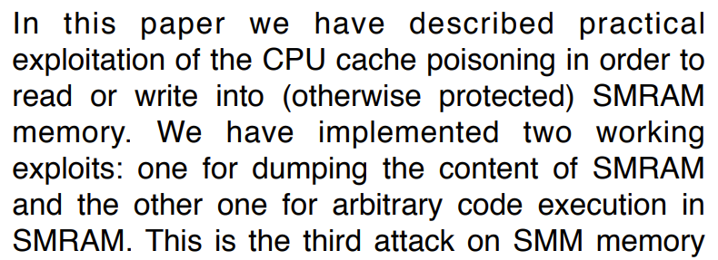



Code Execution Digging up the Past
“Attacking SMM Memory via Intel® CPU Cache Poisoning” by Rafal Wojtczuk and Joanna Rutkowska, 2009

Slide 57
Code Execution Cache Poisoning
67 65 74
20 61 20
6c 69 66
Ring 0
SMRAM
“Attacking SMM Memory via Intel® CPU Cache Poisoning” by Rafal Wojtczuk and Joanna Rutkowska, 2009

Slide 58

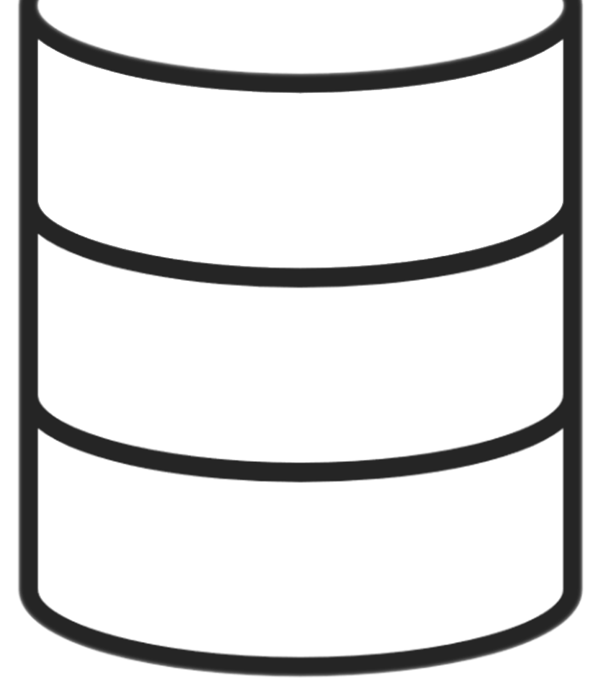
Code Execution Cache Poisoning
67 65 74
20 61 20
6c 69 66
67 65 74
20 61 20
6c 69 66
Ring 0
cache
SMRAM
“Attacking SMM Memory via Intel® CPU Cache Poisoning” by Rafal Wojtczuk and Joanna Rutkowska, 2009

Slide 59
Code Execution Cache Poisoning
67 65 74
20 61 20
6c 69 66
SMI
Ring 0
SMM
cache
SMRAM
“Attacking SMM Memory via Intel® CPU Cache Poisoning” by Rafal Wojtczuk and Joanna Rutkowska, 2009

Slide 60
Code Execution Cache Poisoning
67 65 74
20 61 20
6c 69 66
write-back
Ring 0
SMM
cache
SMRAM
“Attacking SMM Memory via Intel® CPU Cache Poisoning” by Rafal Wojtczuk and Joanna Rutkowska, 2009

Slide 61
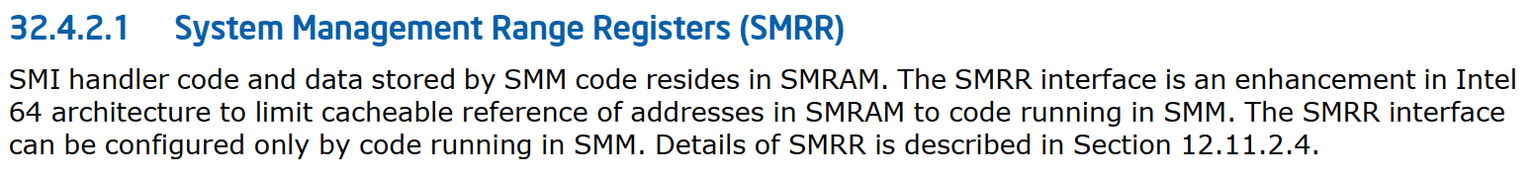
Code Execution SMRR
Intel® 64 and IA-32 Architectures Software Developer Manual

Slide 62
Code Execution SMRR + S3
/**
Enable SMRR register if SMRR is supported and SmmCpuFeaturesNeedConfigureMtrrs()
returns TRUE.
**/
VOID
EFIAPI
SmmCpuFeaturesReenableSmrr (VOID)
{
if (mSmrrSupported && mNeedConfigureMtrrs) {
AsmWriteMsr64 (mSmrrPhysMaskMsr, AsmReadMsr64(mSmrrPhysMaskMsr) |EFI_MSR_SMRR_PHYS_MASK_VALID);
}
}

Slide 63
Code Execution Full Recipe
1
Set the value of mSmrrSupported to 0
2
Go into S3 sleep mode
3
Return from S3
4
Write to SMRAM through the cache

Slide 64
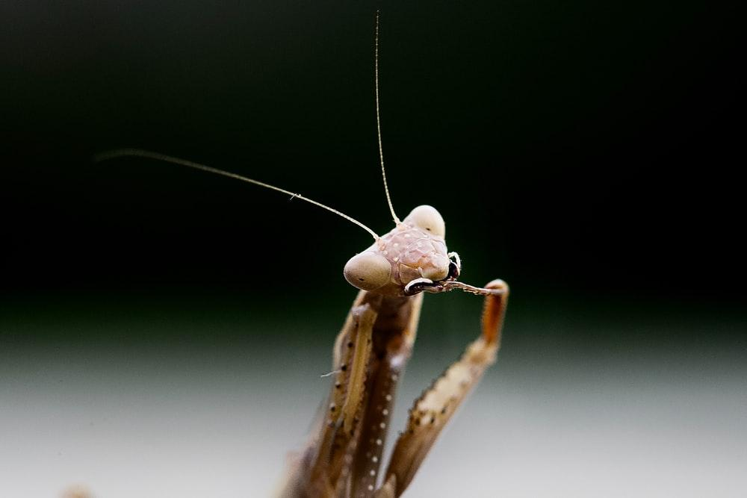
Demo
LET’S PRAY
TO THE DEMO GODS
Photo by Andrey Tikhonovskiy on Unsplash

Slide 65



The FW Ecosystem
edk2
IBVs
edk2
…
edk2
https://en.wikipedia.org/wiki/American_Megatrends; https://en.wikipedia.org/wiki/Insyde_Software

Slide 66







The FW Ecosystem
edk2
IBVs
edk2
…
edk2
OEMs
edk2
edk2
edk2
edk2
edk2
edk2
edk2
edk2
> 200 million devices in 2020 only
https://en.wikipedia.org/wiki/American_Megatrends; https://en.wikipedia.org/wiki/Insyde_Software; https://en.wikipedia.org/wiki/Lenovo; https://en.wikipedia.org/wiki/Dell; https://en.wikipedia.org/wiki/Gigabyte_Technology; https://en.wikipedia.org/wiki/Asus; https://en.wikipedia.org/wiki/HP_Inc; https://en.wikipedia.org/wiki/Acer_Inc; https://en.wikipedia.org/wiki/Intel; https://en.wikipedia.org/wiki/Micro-Star_International

Slide 67
The FW Ecosystem
edk2
IBVs
CVE-2021-33164, CVE-2022-34325, CVE-2022-33986, CVE-2022-33985, CVE-2022-33984, CVE-2022-33983, CVE-2022-33982, CVE-2022-33909, CVE-2022-33908, CVE-2022-33907, CVE-2022-33906, CVE-2022-33905, CVE-2022-32267, CVE-2022-32266, CVE-2022-31243, CVE-2022-30774, CVE-2022-30773
edk2
…
edk2
OEMs
edk2
edk2
edk2
edk2
edk2
edk2
edk2
edk2
https://en.wikipedia.org/wiki/American_Megatrends; https://en.wikipedia.org/wiki/Insyde_Software; https://en.wikipedia.org/wiki/Lenovo; https://en.wikipedia.org/wiki/Dell; https://en.wikipedia.org/wiki/Gigabyte_Technology; https://en.wikipedia.org/wiki/Asus; https://en.wikipedia.org/wiki/HP_Inc; https://en.wikipedia.org/wiki/Acer_Inc; https://en.wikipedia.org/wiki/Intel; https://en.wikipedia.org/wiki/Micro-Star_International

Slide 68
Generate DMA transactions
Trigger SMIs
Write to specific physical memory
Ring 3
Ring 0
Ring -2

Slide 69
Exploitation From Ring 3 Generating DMA Transactions
DMA request
hook
⁞
Processing Request
⁞
Trigger SMI
Validate
Returns file
Use
timeline

Slide 70
Exploitation From Ring 3 Generating DMA Transactions
Read file
hook
⁞
Processing Request
⁞
Trigger SMI
Validate
Returns file
Use
timeline

Slide 71
Exploitation From Ring 3 Generating DMA Transactions
Read file
hook
⁞
Processing Request
⁞
Trigger SMI
Validate
Returns file
Use
timeline

Slide 72
Generate DMA transactions
Trigger SMIs
Write to specific physical memory
Ring 3
Ring 0
Ring -2

Slide 73
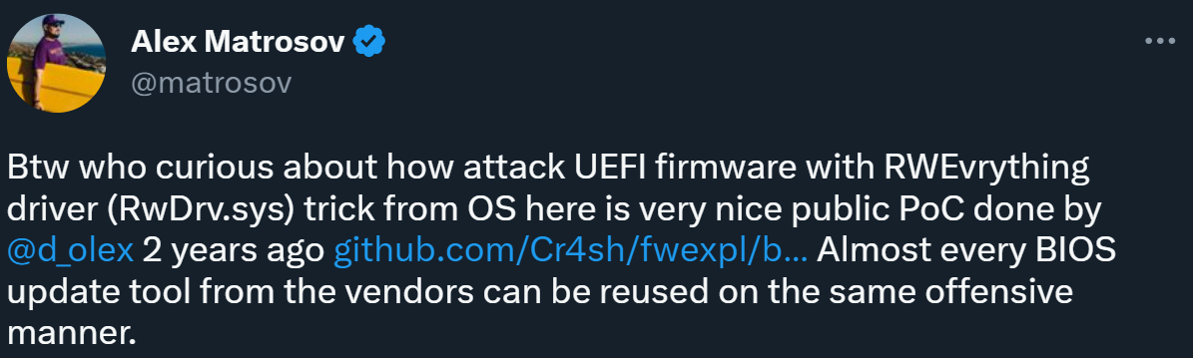
Exploitation From Ring 3
https://twitter.com/matrosov/status/1045922881677352961

Slide 74
Exploitation From Ring 3 Triggering SMI
AMI provides:
A Linux driver (amifldrv_mod)
A signed Windows driver (amifldrv64.sys)
Both drivers expose APIs for triggering any SMI

Slide 75
Generate DMA transactions
Trigger SMIs
Write to specific physical memory
Ring 3
Ring 0
Ring -2

Slide 76
Exploitation From Ring 3 Writing to Physical Memory - Background
RAM
SMRAM
User-space [Ring 3]
Kernel [Ring 0]
SMM [Ring -2]
mailbox
user-land ptr (VA)
smm ptr (PA)
buffer
PA = Physical Address; VA = Virtual Address

Slide 77
Exploitation From Ring 3 Writing to Physical Memory - Windows
__int64 buffer_mapping_ioctl() {
gMailboxPA = trigger_smi(0xd9);
}
Ring 3
Ring 0
mailbox
buffer
PA = Physical Address; VA = Virtual Address

Slide 78
Exploitation From Ring 3 Writing to Physical Memory - Windows
__int64 buffer_mapping_ioctl() {
gMailboxPA = trigger_smi(0xd9); // populates mailbox
gMailboxVA = map_pa_to_usr_va(gMailboxPA, 0x18, 0);
}
Ring 3
Ring 0
gMailboxVA
mailbox
buffer
PA = Physical Address; VA = Virtual Address

Slide 79
Exploitation From Ring 3 Writing to Physical Memory - Windows
__int64 buffer_mapping_ioctl() {
gMailboxPA = trigger_smi(0xd9); // populates mailbox
gMailboxVA = map_pa_to_usr_va(gMailboxPA, 0x18, 0);
gBufferPA = *(gMailboxVA + 8);
gBufferVA = map_pa_to_usr_va(gBufferPA, 0x11000, 1u);
}
Ring 3
Ring 0
gMailboxVA
mailbox
gBufferVA
buffer
PA = Physical Address; VA = Virtual Address

Slide 80

Exploitation From Ring 3 Writing to Physical Memory - Windows
__int64 buffer_mapping_ioctl() {
gMailboxPA = trigger_smi(0xd9); // populates mailbox
gMailboxVA = map_pa_to_usr_va(gMailboxPA, 0x18, 0);
gBufferPA = *(gMailboxVA + 8);
gBufferVA = map_pa_to_usr_va(gBufferPA, 0x11000, 1u);
*(user_memory) = gMailboxVA;
*(user_memory + 0x08) = gBufferVA;
}
Ring 3
Ring 0
to modify *(gMailboxVA + 8)
gMailboxVA
mailbox
gBufferVA
buffer
PA = Physical Address; VA = Virtual Address

Slide 81
Exploitation From Ring 3 Writing to Physical Memory - Windows
Ring 3
Ring 0
Trigger buffer_mapping_ioctl twice:
Get access to gMailboxVA
Modify mailbox and exploit the race-condition
gMailboxVA
mailbox
gBufferVA
buffer
arbitrary physical address
gBufferVA

Slide 82
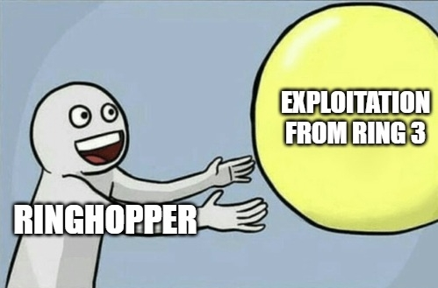
Exploitation From Ring 3 Writing to Physical Memory - Windows
https://imgflip.com/i/7rmjdo

Slide 83

Exploitation From Ring 3 Writing to Physical Memory - Windows
https://imgflip.com/i/7rmjdo

Slide 84
Exploitation From Ring 3 Writing to Physical Memory - Windows
__int64 buffer_mapping_ioctl() {
gMailboxPA = trigger_smi(0xd9);
// [...]
if ( !gMailboxVA ) {
gMailboxVA = map_pa_to_usr_va(gMailboxPA, 0x18, 0);
if ( gMailboxVA ) {
// [...]
gBufferPA = *(gMailboxVA + 8);
gBufferVA = map_pa_to_usr_va(gBufferPA, 0x11000, 1u);
}
}
// [...]
*(user_memory) = gMailboxVA;
*(user_memory + 0x08) = gBufferVA;
}

Slide 85
Exploitation From Ring 3 Writing to Physical Memory - Windows
__int64 cleanup_ioctl() {
if ( gMailboxVA )
{
// [...]
gMailboxPA = NULL;
gMailboxVA = NULL;
gBufferPA = NULL;
gBufferVA = NULL;
}
// [...]
}
no unmap of gMailboxVA in cleanup IOCTL

Slide 86
Exploitation From Ring 3 Writing to Physical Memory - Windows
Trigger buffer_mapping_ioctl to get mailboxVA
Trigger cleanup_ioctl

Slide 87

Exploitation From Ring 3 Writing to Physical Memory - Windows
Exploit the race condition:
Trigger buffer_mapping_ioctl
Check newly mapped physical address
If race condition failed – trigger cleanup_ioctl
Modify mailbox to contain the desired physical address

Slide 88
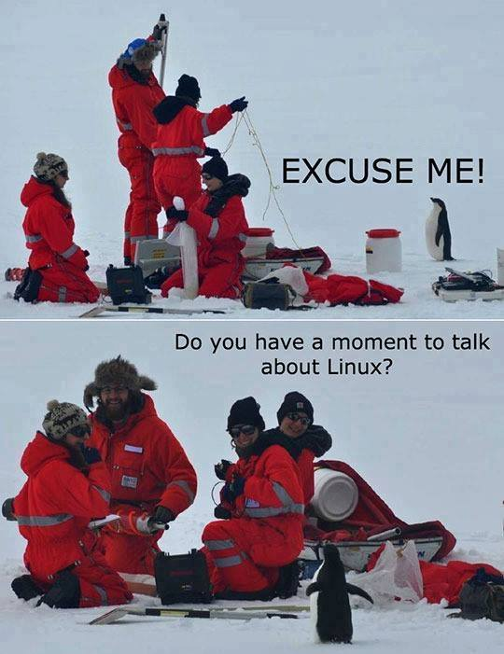
Exploitation From Ring 3 Writing to Physical Memory - Linux
https://www.facebook.com/nixcraft/photos/can-we-talk-about-linux/1740374659309238

Slide 89
Exploitation From Ring 3 Writing to Physical Memory - Linux
from user-space:
int driver_fd = open("/dev/amifldrv", O_RDRW);
int * addr_va = mmap(0, len, PROT_READ | PROT_WRITE, 0, driver_fd, phys_addr);
int file_fd = open("mal_file_path.bin", O_RDWR | O_DIRECT);
read(file_fd, addr_va, MAL_SIZE); // Generating DMA transactions here

Slide 90
Exploitation From Ring 3 Writing to Physical Memory - Linux
from kernel:
static struct file_operations amifldrv_fops =
{
// [...]
.mmap = amifldrv_mmap
};
static int amifldrv_mmap(struct file *file, struct vm_area_struct *vma) {
int status;
unsigned long size = vma->vm_end - vma->vm_start;
// […]
status = remap_pfn_range(vma, vma->vm_start, vma->vm_pgoff, size, PAGE_SHARED);
// […]
}
remap_pfn_range

Slide 91

Exploitation From Ring 3 Writing to Physical Memory - Linux
https://www.reddit.com/r/FuturamaWOTgame/comments/o72q52/the_bad_news_is_that_there_wont_be_any_futurama/

Slide 92
Exploitation From Ring 3 Writing to Physical Memory - Linux
from user-space:
int driver_fd = open("/dev/amifldrv", O_RDRW);
int * addr_va = mmap(0, len, PROT_READ | PROT_WRITE, 0, driver_fd, phys_addr);
int file_fd = open("mal_file_path.bin", O_RDWR | O_DIRECT);
read(file_fd, addr_va, MAL_SIZE); // Generating DMA transactions here
"Bad Address" (EFAULT)

Slide 93
Exploitation From Ring 3 Writing to Physical Memory - Linux
when using
“page-ranges [are] managed without "struct page", just pure PFN” Linux kernel docs
remap_pfn_range

Slide 94
Exploitation From Ring 3 Writing to Physical Memory - Linux
from user-space:
int driver_fd = open("/dev/amifldrv", O_RDRW);
int * addr_va = mmap(0, len, PROT_READ | PROT_WRITE, 0, driver_fd, phys_addr);
int file_fd = open("mal_file_path.bin", O_RDWR | O_DIRECT);
read(file_fd, addr_va, MAL_SIZE); // Generating DMA transactions here

Slide 95
Exploitation From Ring 3 Writing to Physical Memory - Linux
from user-space:
int driver_fd = open("/dev/amifldrv", O_RDRW);
int * addr_va = mmap(0, len, PROT_READ | PROT_WRITE, 0, driver_fd, phys_addr);
int file_fd = open("mal_file_path.bin", O_RDWR | O_DIRECT);
read(file_fd, addr_va, MAL_SIZE); // Generating DMA transactions here. Nope

Slide 96
Exploitation From Ring 3 Writing to Physical Memory - Linux
https://www.reddit.com/r/FuturamaWOTgame/comments/o72q52/the_bad_news_is_that_there_wont_be_any_futurama/

Slide 97
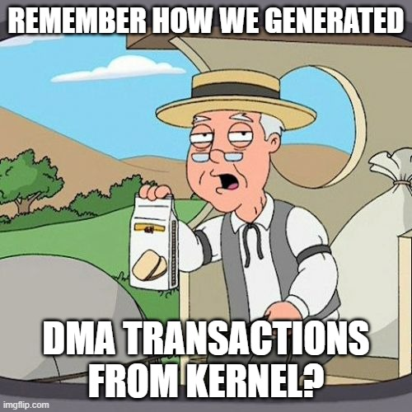
Exploitation From Ring 3 Writing to Physical Memory - Linux
int driver_fd = open("/dev/amifldrv", O_RDRW);
int * addr_va = mmap(0, len, PROT_READ | PROT_WRITE, 0, driver_fd, phys_addr);
phys_addr_of_kernel_module
https://imgflip.com/i/7r9wdw

Slide 98
Generate DMA transactions
Trigger SMIs
Write to specific physical memory
Ring 3
Ring 0
Ring -2

Slide 99
The RingHopper Journey
code execution using SMBASE relocation
write primitives into SMRAM
exploitation from ring 3 using signed drivers
code execution via the S3 boot script (failed)

Slide 100


xor eax, eax; cpuid
Benny Zeltser,
Security Research Team Lead, Intel
Jonathan Lusky,
Security Research Team Lead, Cellebrite

Slide 101
Thank you!
Generated by the DALL·E 2.5 AI system

